Slide 1
Television, Security, and Vigil:
How popular culture can (re)construct nuclear politics

Slide 2
Popular Culture
”Popular culture is both ordinary and exceptional: ordinary in its everydayness, but exceptional in its potential to support and multiply identity, social meaning and relations of power” (Griffin, 2019: 508)
Notes:
When popular culture is taken seriously as a site of power in world politics, the boundaries of what “counts” as politics are rewritten. Importantly, the expansion of these bounds creates room for alternative ideas, identities and possibilities, redefining what knowledge and whose knowledge is prioritized or marginalized. Popular culture shapes political identities and the narratives that sustain them.
Popular culture has been taken seriously in International Relations as a site of meaning-making since the so-called “aesthetic turn” of the 1990s. This project continues this vibrant and growing turn, by asking questions about security and power in reference to the social, cultural, and political reproduction and representations of nuclear weapons and nuclear politics in BBC’s Vigil. Taking seriously the ideas and norms embedded in details of everyday life as trivial as watching TV, this project creates space to examine how people interpret nuclear politics and make it meaningful to them

Slide 3
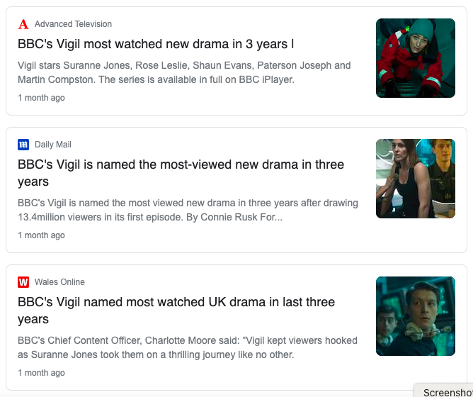
Notes:
Vigil was released by the BBC this year. It has since become the most-viewed drama since 2018’s Bodyguard (a show also depicting national security issues). Vigil is set aboard a Trident Vanguard class nuclear-powered ballistic missile submarine, fictionally named Vigil.
This presentation is going to deconstruct two important representations of nuclear politics in Vigil, and discuss their implications.

Slide 5
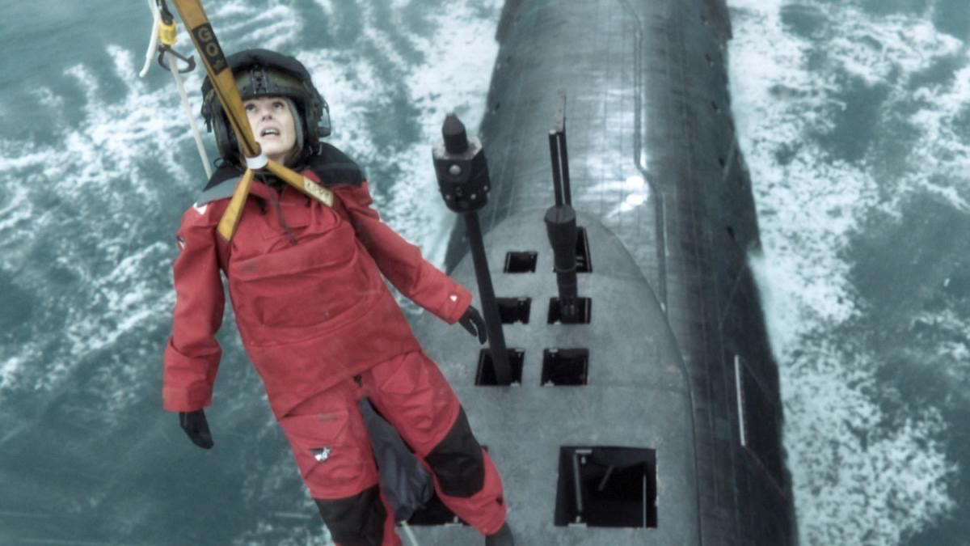
“We’re eight women, 140 men”
“Can you even begin to imagine the tactical challenge?”
“No, no, didn’t think so”.
“confine her to quarters”
Gender
Notes:
The narrative that women do not belong in the nuclear realm is well documented, and probably all too familiar for many of us. Vigil demonstrates the continuation of this narrative into popular culture. Nuclear decision-making is presented as a man’s job both linguistically and visually.
In Episode One, the gender imbalance is explicitly communicated to viewers in script: “We’re eight women, 140 men”.
Whilst the demographics of military personnel stationed on the real Trident submarines is a state secret, in an interview with Metro former Lieutenant Commander, David Lovell, described this as “a pretty realistic number” (Brazier, 2021).
Such a stark gender disparity is unfortunately true to the gender balance in “arms control, non-proliferation and disarmament diplomacy”. According to a UNIDIR study, women are significantly underrepresented in small arms control (20%), as foreign ministers (13%), and as heads of state (6%) and in nuclear diplomacy, gender representation is increasing slower than in other areas (UNIDIR, 2019).
Whilst staggering, “arms control, non-proliferation and disarmament diplomacy” are associated with a more feminine politics than military. Indeed, women make up 10.9% of the British Forces, and 9.8% of the Royal Navy and Marines, with such disparities even more pronounced in leadership positions (UK Gov, 2020).
The fictional crew of Vigil is therefore structured in a way that brings attention to the hegemonic forces of masculinity that continue to shape the nuclear realm. In doing so, the idea that men are responsible for the use of nuclear weapons is presented not only in principle but in reality – if necessary, it would be men operating the UK’s nuclear arsenal.
Beyond gender imbalances, gender is more complexly communicated in Vigil’s script and storyline. In Episode Two, DCI Amy Silva is challenged by Commanding Officer Newsome who asks her “Can you even begin to imagine the tactical challenge?” before immediately answering his own question: “No, no, didn’t think so”.
In Tasker’s (2002) investigation into Hollywood’s depiction of female soldiers, she argues that women are presented as a disruptive presence that must be incorporated into the masculine hegemony, or managed or contained. These ideas are also seen in the BBC’s depiction of women onboard Vigil. The female lead, bestowed with rank within the police force, is denied words by the male commander. Military and strategic tactics are deemed beyond her imagination whilst she is belittled by the commander’s derogatory and mocking answer.
The commander goes on to “confine her to quarters”. Such does significant semiotic work. Silva is excluded from the space, rendering her literally and metaphorically unfit for the room. The paternalistic overtones, parallel to sending a misbehaving child to their room, communicate the notion that this could be for her own good – that perhaps she needs disciplining in order to learn how to behave in this space. Importantly, the semiotic choice has been made to use military jargon: calling the room where she sleeps her “quarters”. This further reinforces the commander’s ease in navigating the military realm whilst creating a powerful interpersonal meaning. Alongside Silva, the audience is left with a sense of exclusion by the use of jargon not used naturally in everyday life. They are aided in identification with Silva, feeling empathetic to the violence of exclusion. In a few short sentences, DCI Silva has been rendered child-like and out of her depth.
This is an example of what Schiappa has termed “bureaucratization” – a rhetorical tool which draws attention to the power struggles at play in the deployment of technical jargon and acronyms. Such language “constructs the realm of nuclear weapons as one reserved for experts”, defining who can and can’t be heard (Considine, 2020).

Slide 6
The Deterrent
“The entire nuclear deterrent rests on just three things. The first, you must have viable weapons. And second, your enemy can't ever know if you'll use them. Which is why we keep the letter of last resort in a safe, inside another safe, on board this boat. The final thing is, your enemy mustn't be able to stop you. So you stay hidden.”
Notes:
Nuclear deterrence refers to the ability to dissuade or prevent conventional or nuclear attack through the threat of nuclear retaliation. It works on the logic that the ability and willingness to use nuclear weapons will render the possessor an impossible target.
Throughout Vigil, the nuclear submarine is referred to as “the UK’s deterrent”, “the nuclear deterrent” or “the deterrent”.
Referring to the nuclear-armed submarine as ”the deterrent” is an example of nominalisation (Richardson, 2007). This means that a process has been transformed into a noun. Vigil’s script uses “deterrent” as noun when, in reality, it is a theory and, many argue, a myth. Such nominalisation leaves no room for doubting the ability of nuclear submarines to deter threat. Deterrence theory is increasingly being challenged, and many postures are moving away from MAD logics. Nonetheless, the nominalised language used in vigil (re)produces certainty around the idea of deterrence. Few viewers are likely to stop and question such covert aspects of script, yet the normalisation and de-politicisation of this language by Vigil is likely to be internalised by viewers.
In episode one, we are given an outline of the logic of deterrence: “The entire nuclear deterrent rests on just three things. The first, you must have viable weapons. And second, your enemy can't ever know if you'll use them. Which is why we keep the letter of last resort in a safe, inside another safe, on board this boat. The final thing is, your enemy mustn't be able to stop you. So you stay hidden.”
This description relies upon the existence of a discursively constructed enemy as well as the centrality of secrecy to nuclear weapon policy. In “Visual Global Politics”, Van Veeren argues that ideas of invisibility are intertwined with cultures of secrecy and security discourses. Invisibility is most often imagined through metaphor as a barrier that prevents sight. Van Veeren demonstrates that something that cannot be seen is either articulated as safer, meaning it needs to be kept secret and concealed, or more threatening and it has to be revealed. Interestingly, nuclear submarines embody a paradox whereby one must understand them as safe and needing to be secret in the hands of “us” and threatening and needing to be revealed in the hands of “them” (Gamson & Stuart 1992). Therefore, understandings of enemies and secrecy are complex and interrelated. Vigil’s script plays on and reinforces these ideas, creating tension through the idea of a high-stakes game of hide-and-seek

Slide 7
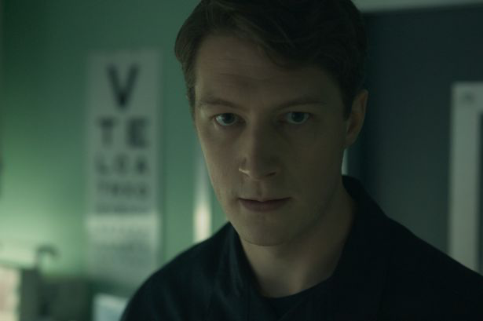
The Russian
Notes:
According to Philpott, fiction depicts war in simplistic ways, often giving viewers just one perspective on a foreign policy issue.
Many have demonstrated that the UK-US “special relationship” extends well beyond close allyship into popular culture. Given this strong Anglophone relationship, it is no surprise that Vigil provides a perspective for viewers in line with UK and US perspectives.
Many scholars have demonstrated a long history of Hollywood demonising peoples, cultures and ethnicities, entrenching highly negative views of the US’s various others. Such popular visualisation of supposed enemies strips them of their humanity and makes their killing not just possible but desirable. The BBC’s Vigil (re)produces the narrative of the Russian enemy, through the “big reveal” of the “bad guy" of the all clichés: a Russian Spy. There is a notable trend in the presentation of spies in that if the agent is Western they are the good guy who wins, whilst if the agent is Eastern, they are the bad guys and defeated.
As well as the antagonist, in Vigil, fictional anti-nuclear protesters and politicians are delegitimised as dupes for Russia, operating as versions of this discourse.
It should come as no surprise that a drama portraying nuclear security relies on Cold-War narratives. Since the Cold War, there is a common trope in fiction (across all genres and subject matters) to depict Russia and Russians as a principal threat to world peace. According to Klaus Dodds, “the Soviet Union is invariably shown to be politically unpredictable”. Sharp showed how the Soviet Union was textually and visually constructed as “Other” for American and international readerships. Today, this trope survives the end of the Cold War. Writing in the context of cyber security, Wardle comments on how ”the Russians” has become such a common synonym for threat, so much so that “blaming the Russians” is a common means of hiding or diminishing other threats, many of which are far closer to home.
This frame preserves UK (and, vicariously, the US) as a nuclear victim, not a nuclear perpetrator, simplifying the messy complexity of the real world. Vigil’s viewers are given a simplistic narration of nuclear security and threat, and one which (re)produces existing ideas of “us” and “them”.

Slide 8
Conclusion
It is important that Political Science and International Relations take fictional dramas seriously
Notes:
"It is important that Political Science and International Relations take fictional dramas seriously”. These TV shows can influence public opinion by challenging or reinforcing the narratives of official policies. They are also an important reflector and driver of political consciousness relating to particular issues. The future political possibilities and limits of nuclear politics is shaped by relations of power, knowledge, and discourse, accessible to us only when we take popular culture seriously.

Slide 9
Recommended further reading:
Aubrey. (1982). Nukespeak : the media and the bomb . Comedia.
Bleiker. (2018). Visual global politics . Routledge.
Chilton. (1985). Language and the nuclear arms debate: nukespeak today . Pinter.

