Slide 1
YWNGI event: Security, Nuclear Weapons and the Impact of the War in Ukraine The EUNPD Consortium and its engagement with the Next Generation
Manuel Herrera, Researcher at the International Affairs Institute (IAI) Rome, and PhD student at the King Juan Carlos University, Madrid

Slide 2
What is the Consortium?
In July 2010 Council Decision 2010/430/CFSP established “a European network of independent non-proliferation think tanks in support of the implementation of the European Union strategy against Proliferation of Weapons of Mass Destruction”.
A network bringing together foreign policy institutions and research centers from across the EU to encourage political and security-related dialogue and the long-term discussion of measures to combat the proliferation of weapons of mass destruction (WMD) and their delivery systems.

Slide 3
What is the Consortium?

Slide 4
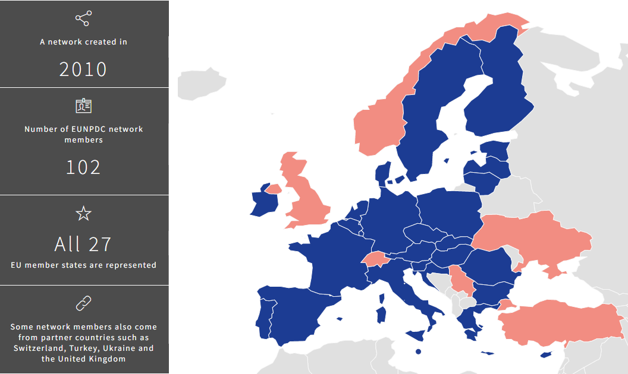
The Network

Slide 5
Mission and activities
The main aim of the network of independent non-proliferation and disarmament think tanks is to encourage discussion of measures to combat the proliferation of weapons of mass destruction and their delivery systems within civil society, particularly among experts, researchers and academics.
The aim of the network is to enhance the awareness in third countries of the challenges related to WMD and conventional weapons proliferation through activities such as dedicated education and outreach projects.
To that end, the Consortium may establish cooperation with specialized institutions and research centers in third countries, in particular in those with which the EU is conducting specific non-proliferation dialogues.

Slide 6
Mission and activities
The Consortium works through the organization of expert meetings, international conferences, ad hoc seminars and consultative meetings with representatives of EU institutions.
In particular, one of the flagship events of the project, the Annual Conference, has raised awareness over the years about the EU Strategy against the proliferation of WMD and the EU Strategy to combat illicit accumulation and trafficking of SALW and their ammunition, and associated implementation efforts by the EU.
In addition, the Consortium provides ad-hoc expertise through reports, recommendations and policy papers to the office of the High Representative of the Union for Foreign Affairs and Security Policy.
It also produces publications on the full range of non-proliferation and disarmament issues, including both conventional and non-conventional arms.
Finally, the Consortium provides relevant e-learning courses, internships, proliferation awareness training for specialists in natural sciences and other relevant fields and arranges annual study visits to Brussels for the participants in the UN Programme of Fellowships on Disarmament.

Slide 7
The Next Generation Initiatives
Next Generation Workshop
EU Non-Proliferation and Disarmament Internships
Next Generation Papers
eLearning Course on Non-proliferation, Disarmament and EU Policies
Proliferation Awareness Courses

Slide 8
For further information about these initiatives please visit the following links:
https://www.nonproliferation.eu/activities/education-programmes/
https://www.nonproliferation.eu/activities/international-conferences/next-generation-workshop/
https://www.nonproliferation.eu/activities/online-publishing/next-generation-papers/

Slide 9
Thank you very much for your attention!!

